Slide 1

Space Range and Display
Schedule Application
December 2006
Prasanth John
Notes:
1

Slide 2
What is SRD Schedule Application?
This application is basically required to support the set up and maintenance of scheduled events. The various stages in the life cycle of an Event is also controlled in this application.
In a more business specific term, schedule is an activity calendar to show when stores are planned to complete various space, range and merchandising activities. It is used to plan when the head office activities to support a successful merchandising launch should be completed and to help plan when other initiatives can be launched in store. The schedule can hold any space, range and merchandising activity planned for the company but it is mainly focused on holding merchandising activity.
Notes:
2

Slide 3
Why SRD Schedule Application?
To enable efficient management of the relationship between future Space, Range and Merchandising events
Simple visibility of all Space, Range and Merchandising Events to the business and other infrastructure systems.
Enabler to allow linking of Planning Group Events within other infrastructure systems and processes.
A more accurate schedule for Space, range and merchandising.
A more productive working process to maintain the SCHEDULE that is less reliant on manual processes compared to the current system.

Slide 4
Basic Architecture
Floor Planning
JDA
Planogram
Generator
Master Planograms
Create Store Specific Merch Plans
Display Hierarchy Maintenance
RMS
Space Planning
Planned Space & Authorisation
Maintain Display Group details
Change TPNB/ Display Group links for Event
Create Master Planograms
Set Space Break for Store/Display Group
Authorise Store/Display Groups
Display Hierarchy
Product Details
Data
Warehouse
Unauthorised Ranges
Reconciliation Data
Range Info
Range Events
Authorised Store Display Groups
Create reports
Unauthorised Ranges
Authorised Ranges
IFO
Supplier
Ordering
Store
Clustering
Store Clusters
Overlays
Assort
Last Authorised Ranges
Ranges in
Progress
Retail
Range
SRD
Schedule
Range Events
Forecast Demand
Create Purchase Orders
Create Store Clusters and Overlays and link to Display Group
Set up Store Ranging Attributes
View ‘in progress’ Ranges for Range Event
Reconcile Plans & Ranges
Authorise ranges
Create Store Specific Ranges
Cluster
Ranges
Create Planning Group and Range Events
Create Ranges for Range Event
?
Seasonal
Modelling
Supported Space Breaks
Store Counts
Store/Product
Model Allocation of Seasonal/Promotional lines
Supp Plans &
Ranges Matrix
Store Actual Ranges
CR
Store
Ordering
?
Allocations
Update Supported Space Breaks per Display Group and Equipment Type
Store counts
Switch on Store Ordering for non-automated New Lines
Push Stock into Stores
User Permissions
SRD Security Controls
Web
Publisher
User Permissions
Publish Retail Range Reports?
PublishPlanograms
CRDB
RPAS
IKB
RRDB
Storeline
Switch on Store Ordering for automated New Lines
Create Shelf Edge Labels

Slide 5
SRD Schedule and the Events
BUSINESS RULES
SRD SCHEDULE
STORE CLUSTERS
DISPLAY GROUPS
SPACE EVENT
EVENTS
PLANNING EVENT
RANGE EVENT
ESSENTIAL PRODUCT LAUNCHES
Business Rules
List of valid activity types and whether the activity type is a Range or Space activity
The default values for Merchandise Plan Tracking indicator and the CR system indicator for each activity type.
Percentage of Range change allowed for each activity type
The minimum lead time required for an event
Limit on the overall length of an event
Limit on how far in future an event can be launched
The number of weeks an Essential Product Launch event is created prior to the launch date
The number of weeks an unused Essential Product Launch event remains on the schedule before it is deleted.
NEW PRODUCTS

Slide 6
Pre Scheduling activities
COMERCIAL TEAM
GOVERANCE TEAM
DRAFT
SIGN OFF
LOAD
Sep
Dec
MERCH TEAM
SPACE TEAM
Life Cycle of an Event..
CANCELLED
PENDING
PRE RANGING
READY
CRST
IN PROGRESS
AUTHORISED
UNLOCKED

Slide 7
Event Statuses
Pending - When a ranging event is added to the SCHEDULE
Pre Ranging - When the Ranging Controls Team is ready to start any Pre-Ranging work
Ready - Once the Ranging Controls team has completed all of the Pre-Ranging work
CRST - After the Ranging event details have been passed to the Ranging
In Progress - Once the new ranges have been created within the Ranging System
Unlocked – When changes need to be made to an unauthorised Range
Cancelled – When the Range has been cancelled
Authorised – When the Ranges have been reconciled and authorised at the Ranges In Progress application

Slide 8
Essential Product Launches
Every weekend the system automatically creates a planning group event with a launch date of the Monday of week + 4, for every merchandising group known to the system. Each of these planning groups contains a single ranging event. If the commercial team decide that they need to make a range change and there isn't a planned event on the schedule then they contact the Ranging Controls team to ask for the Essential Product Launch event for that week to be opened.
Differences EPL and Ranging Events
Range changes due to an Essential Product Launch event are reported on the Weekly Range Change report rather than the Managing Your range report.
Stores are not tracked on the merchandise plan tracker
Any new lines launched are reported on the MIS Out of Cycle I4B report

Slide 9
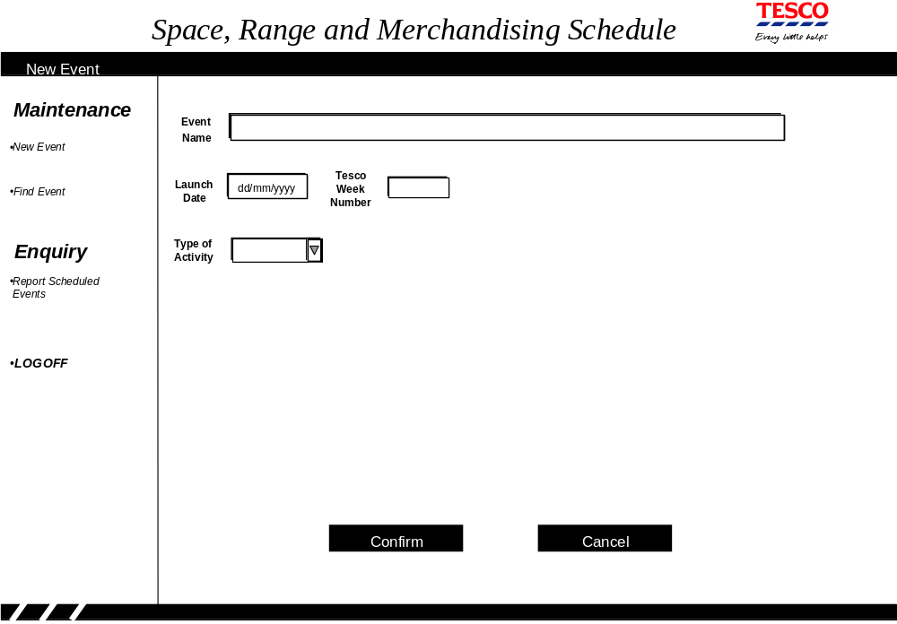
SRD Schedule Screens

Slide 10
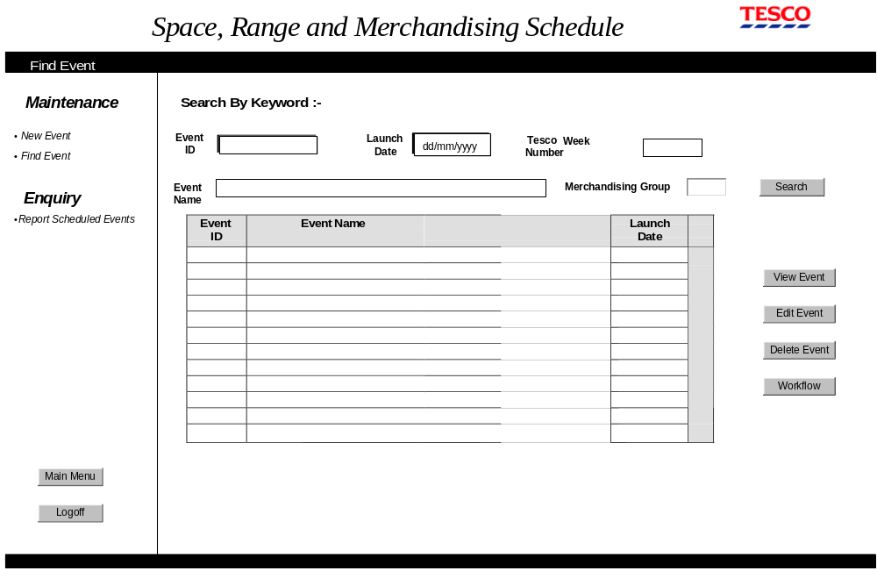
SRD Schedule Screens

Slide 11
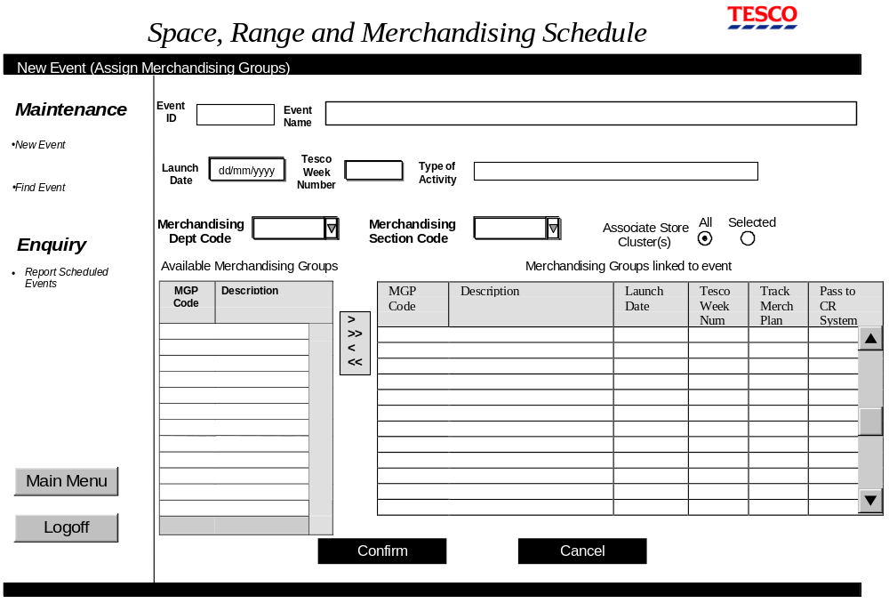
SRD Schedule Screens

Slide 12
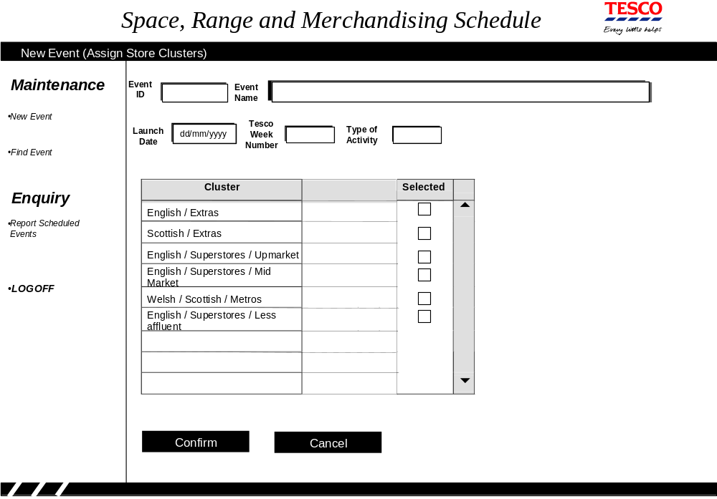
SRD Schedule Screens

Slide 13
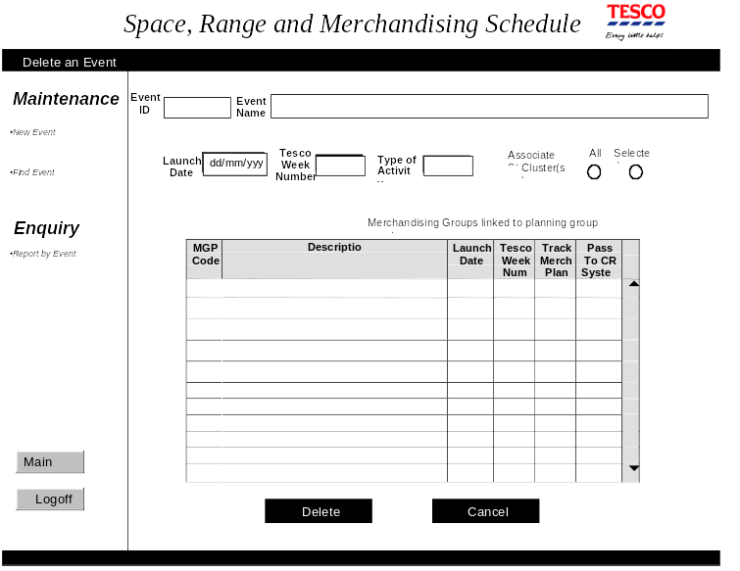
SRD Schedule Screens

Slide 14
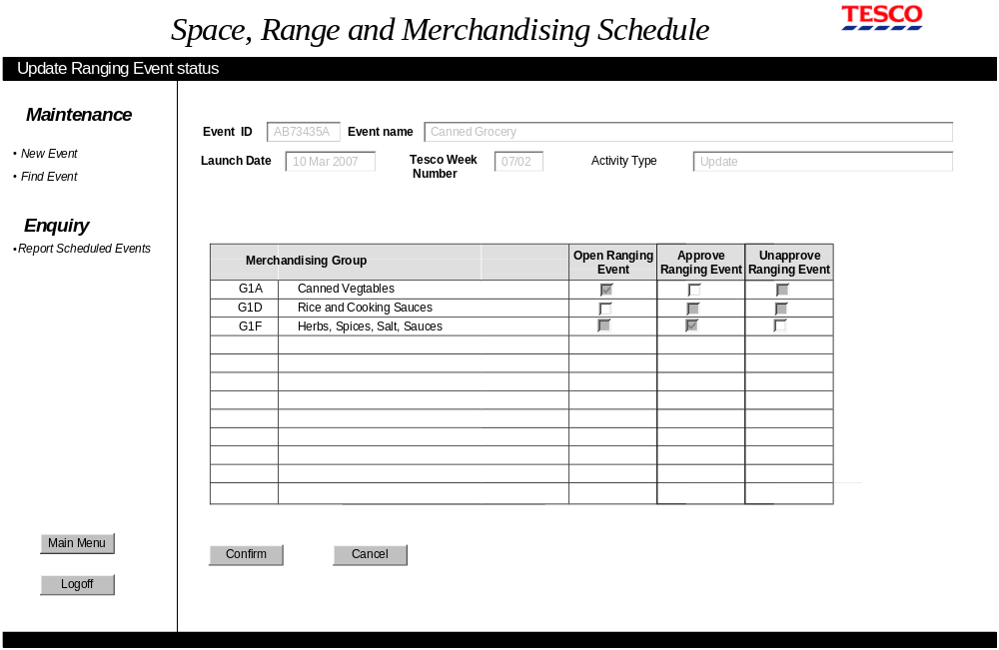
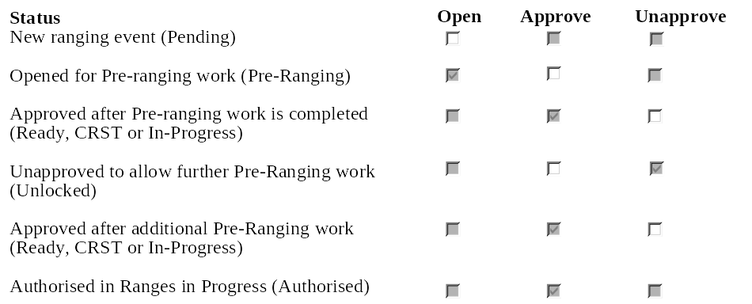
SRD Schedule Screens

Slide 15
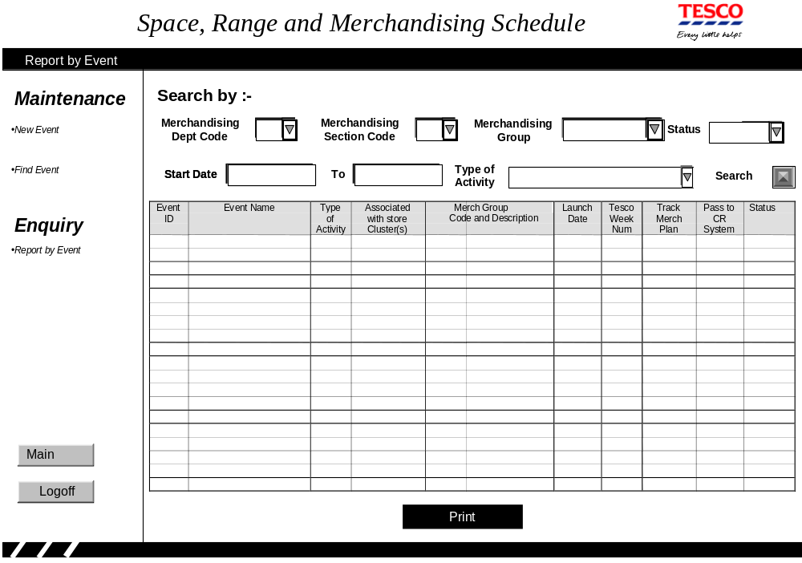
SRD Schedule Screens

Slide 16
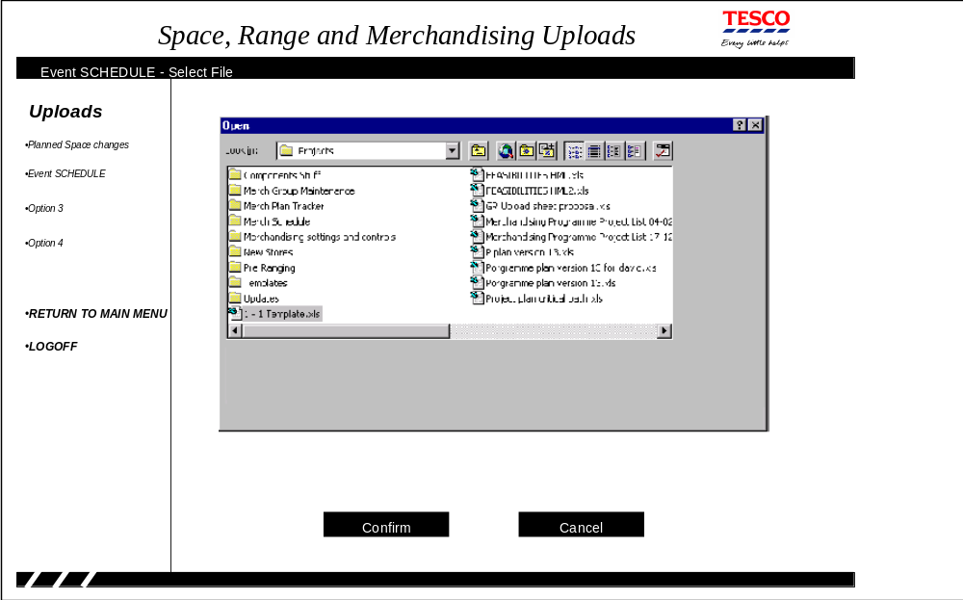
SRD Schedule Screens

Slide 17
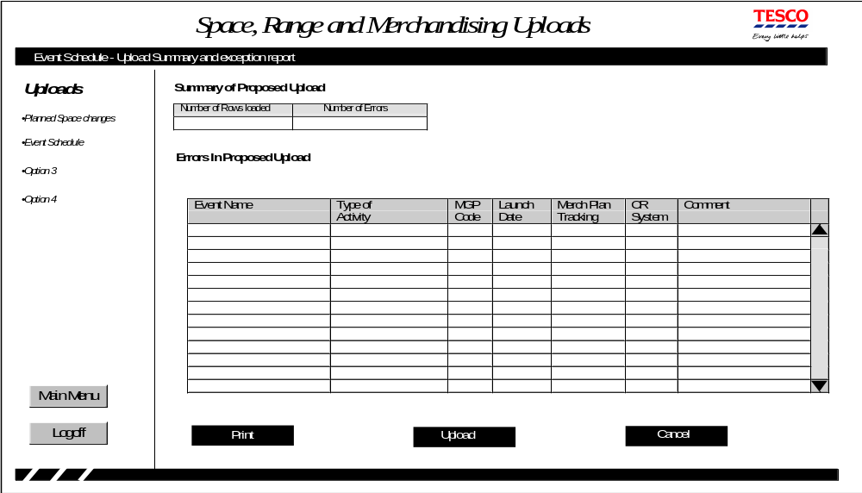
SRD Schedule Screens

Slide 18
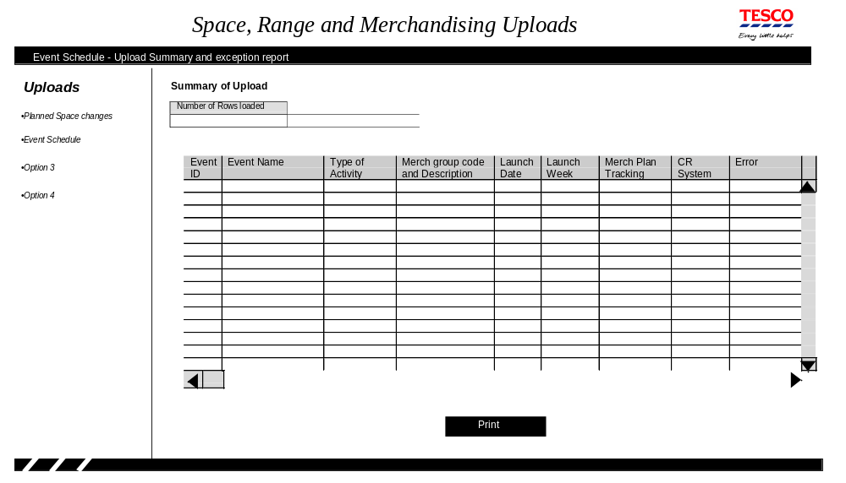
SRD Schedule Screens

Slide 19
SRD Schedule Screens
Space Range and Merchandising Schedule
Selected Events only
Planning Group Event XXYXXMXX XXXXXXXXXXXXXXXXXX for Activity Type XXXXXX
is Approved for launch dd/mm/yy (week nn)
It applies to ENGLAND METROS
SCOTLAND AND WALES EXTRA
Store clusters
Planning Group Event XXYXXMXX XXXXXXXXXXXXXXXXXX for Activity Type XXXXXX
is Unapproved for launch dd/mm/yy (week nn)
It applies to ALL Store Clusters
and
Merchandising Launch Tesco Track CR
Group Date Wk. Status Plan Sys
G1A Canned Vegatables dd/mm/yy 07/14 Pending Y Y
G1B Soup dd/mm/yy yy/ww Approved Y Y
Planning Group Event XXYXXMXX XXXXXXXXXXXXXXXXXX for Activity Type XXXXXX
is Unapproved Pending for launch dd/mm/yy (week nn)
It applies to ALL Store Clusters
and no merchandising groups are currently assigned

Slide 20
SRD Schedule Secession Summary
What is SRD Schedule
Why SRD Schedule
Basic Architecture
SRD Schedules and Events
Pre Scheduling activities
Life Cycle of and Event
Event Statuses
Essential Product launches
SRD Screen shots
  New Event
  Find Event
  Assign Display Group
  Assign Store Clusters
  Delete Event
  Update Event
  Event Report
  Upload Event
  Upload Summary
  Sample Report

Slide 21
Thank You..!!

